Slide 1
Project Presentation
Seminar: Computational Social Science
Rethinking volunteering – digital engagement 4 inclusion
S. Wörner, M. Wachsmuth, L. Shi, Y. Goetz, T. NGO

Slide 2

Agenda
introduction of our team
discussion of problem and solution
presentation of our idea and design

Slide 3
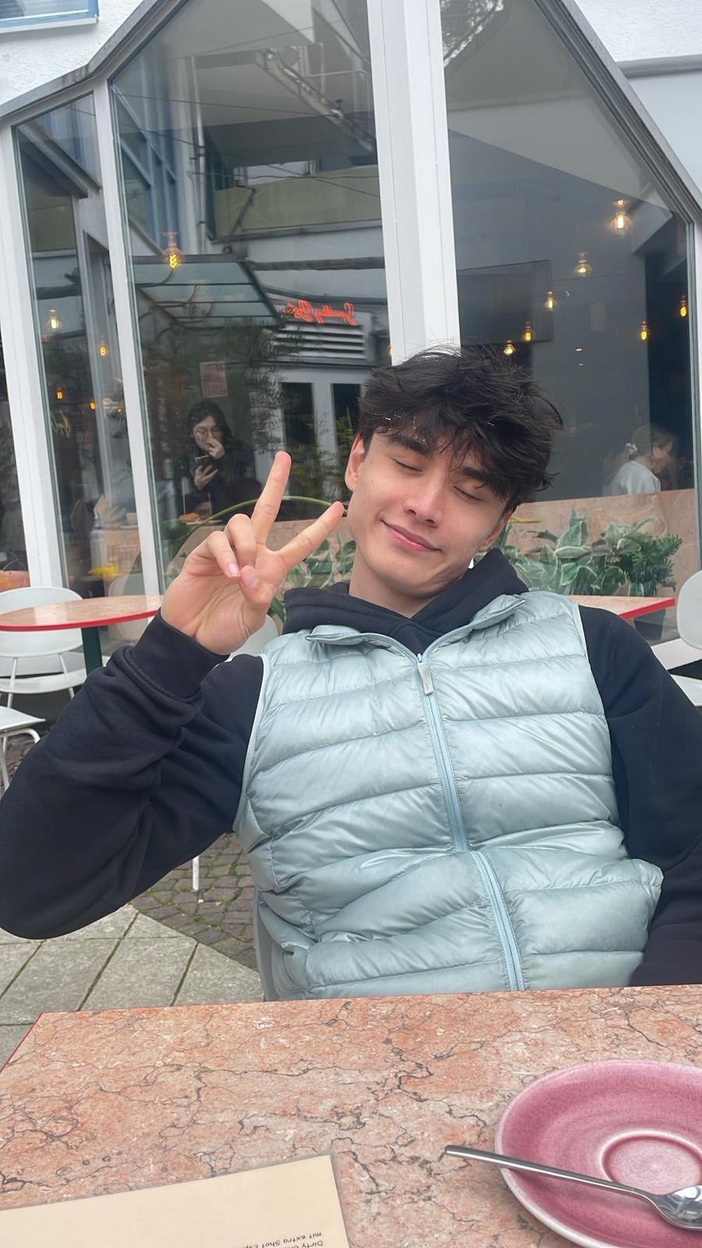
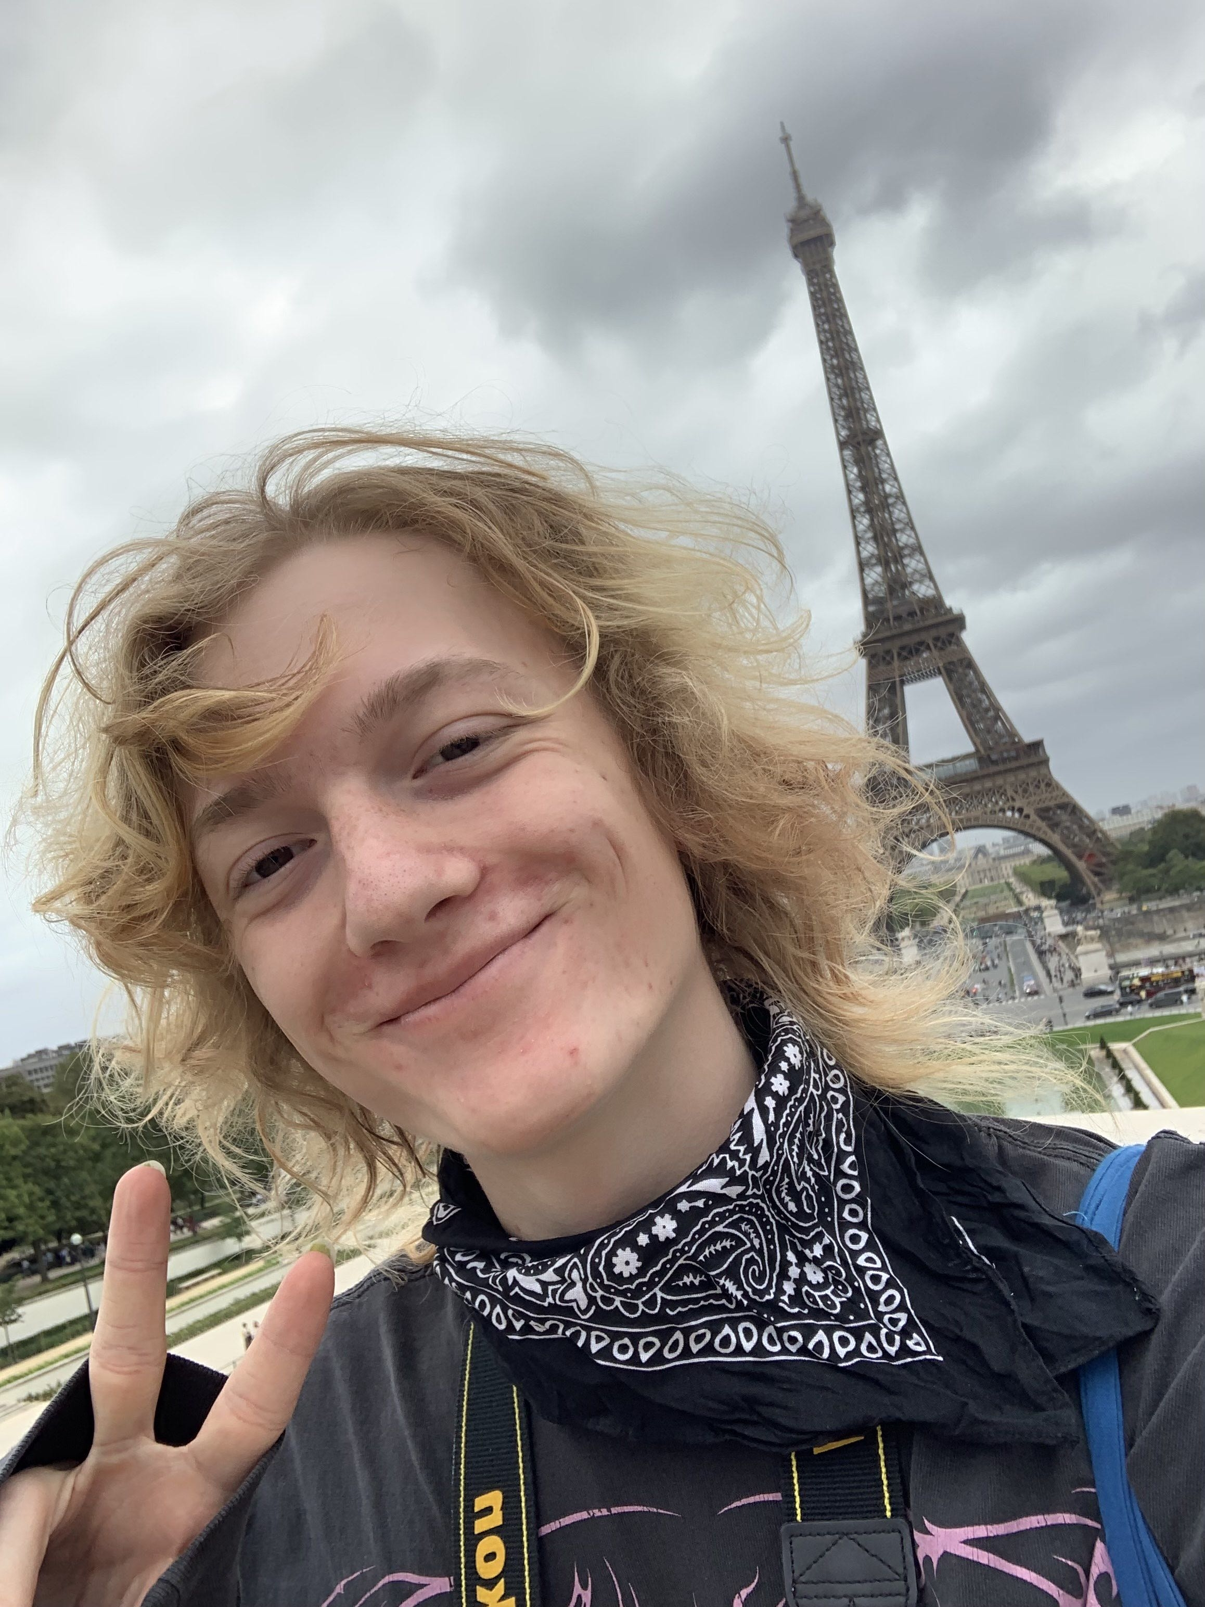
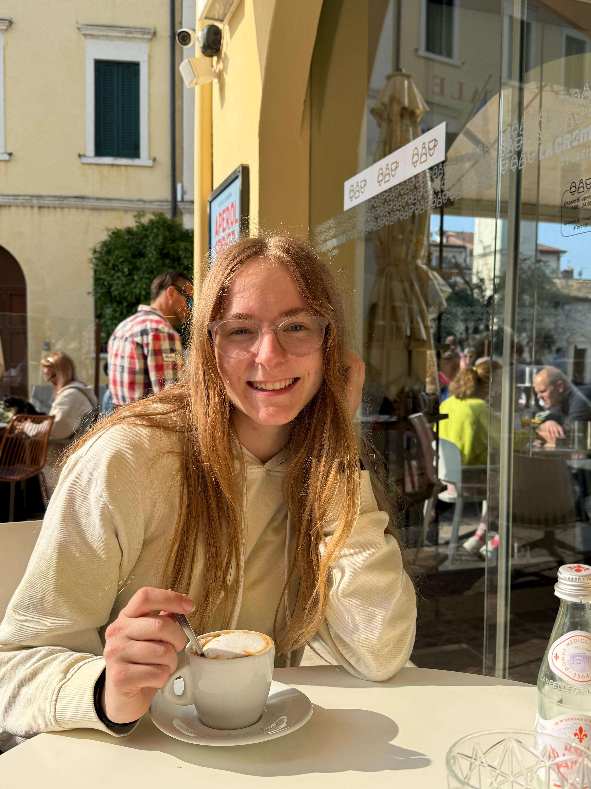
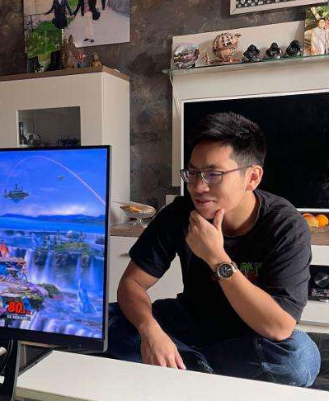
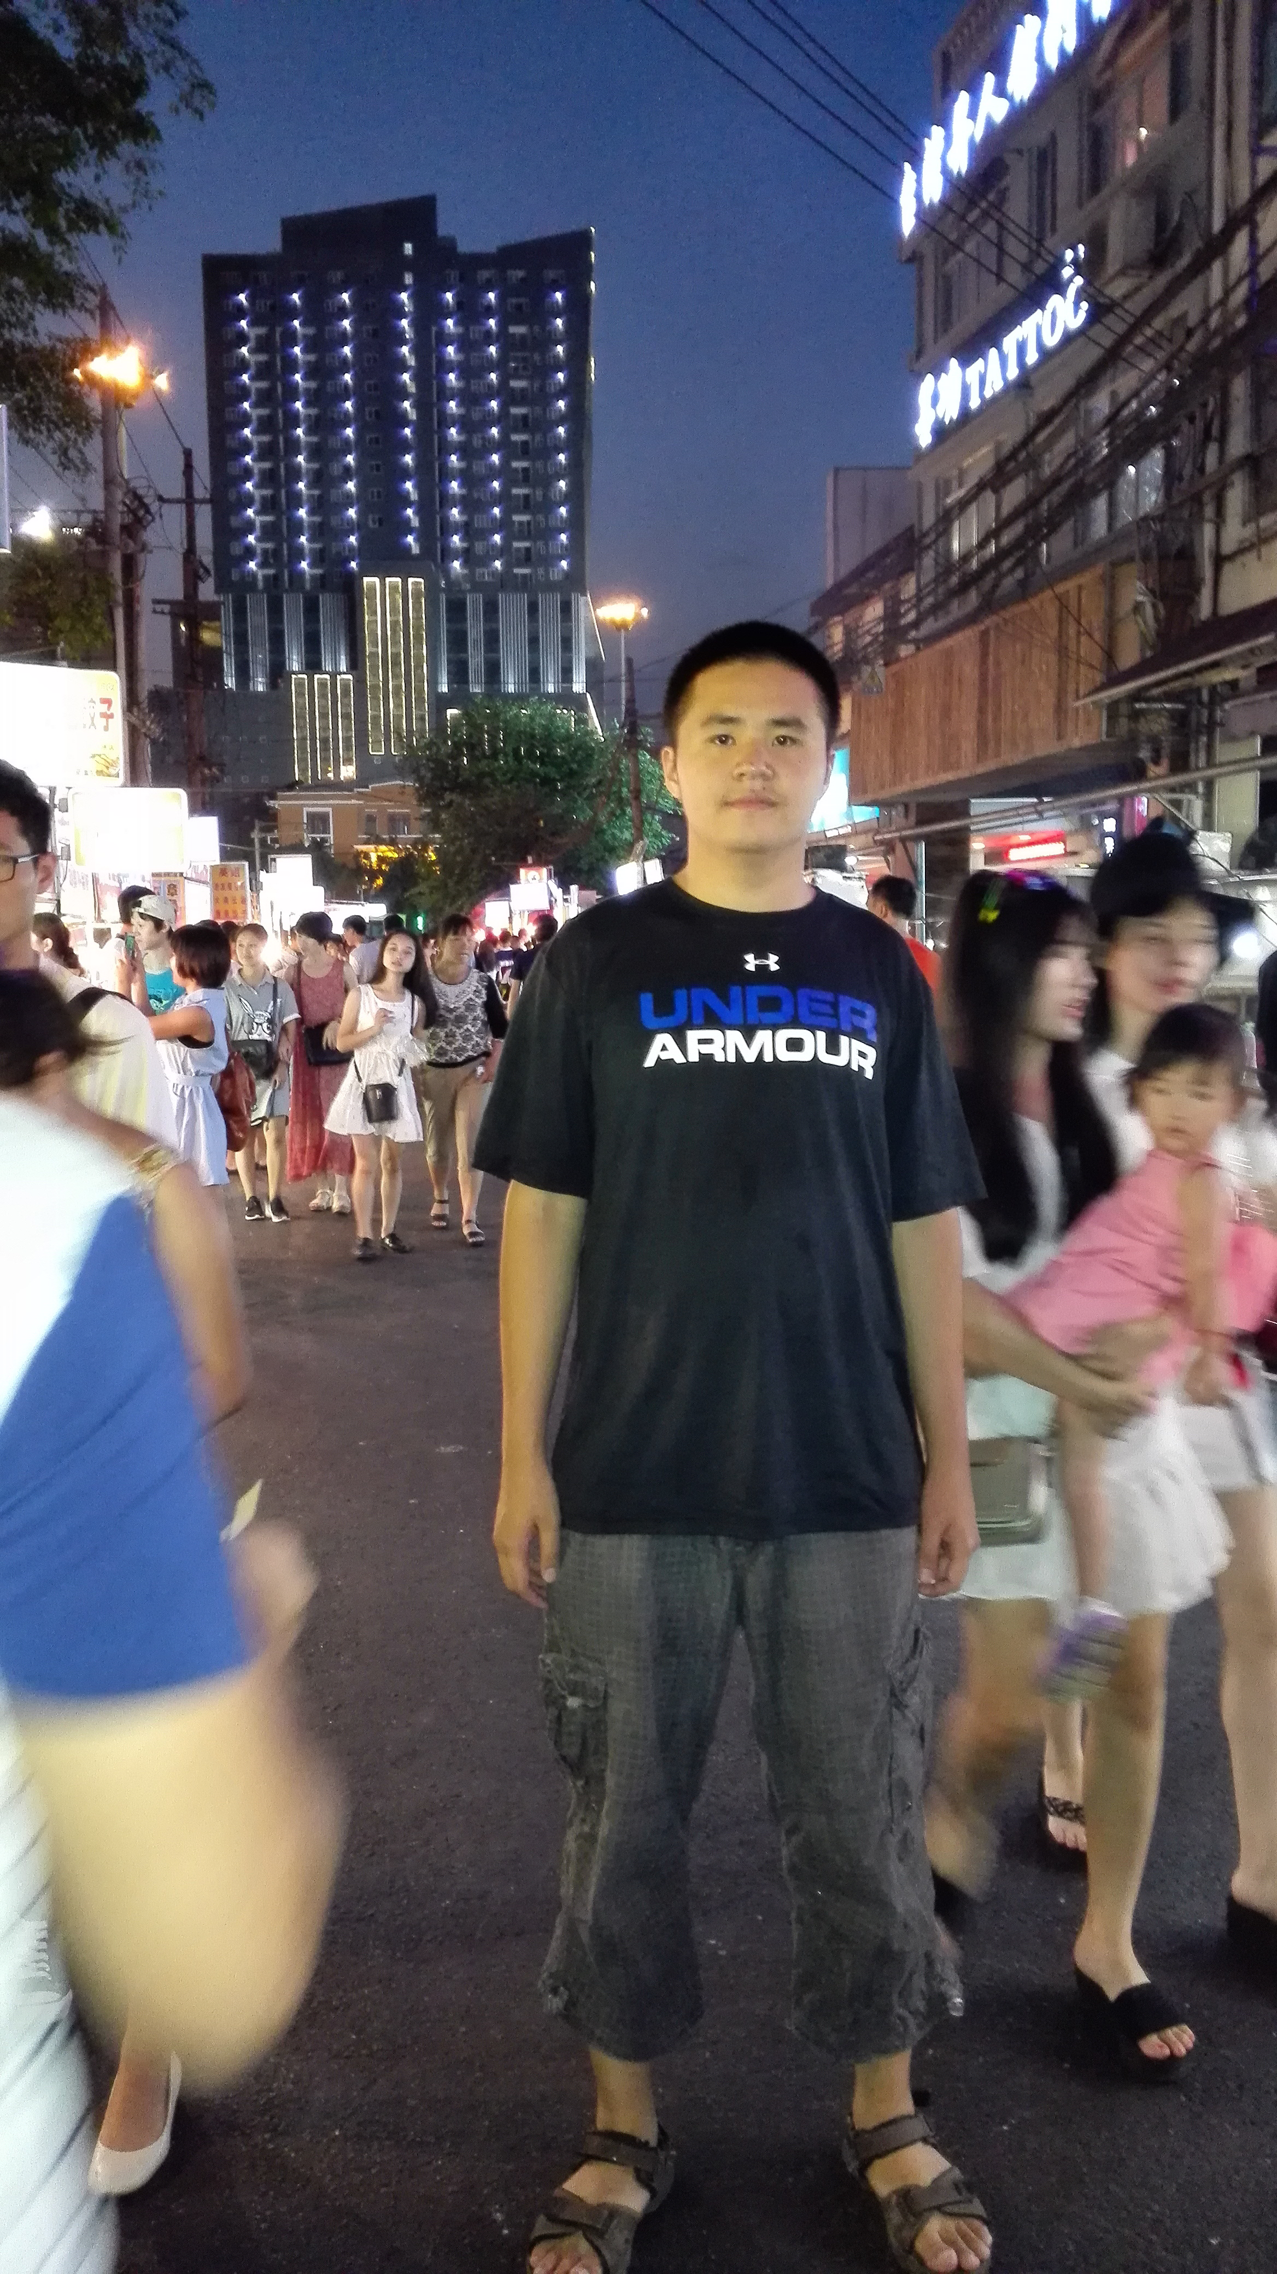
Who are we?
Our team:
2x Information Systems Bachelor students
3x Computer Science Bachelor students
Luca
Marlon
Sophie
Thommy
Yan

Slide 4
The Problem
(mostly elderly) having problems finding their way in the digital world​
lack the digital skills or capacity to look up solutions on their own online​
rely on personal, human assistance ​
many people have the ability and want to support others​
need a way to connect​
our platform enables that

Slide 5

The idea
app for connecting the people who need help and those that can render it
service requests that can be processed
different view/layout for requesting and helping side
chatting option

Slide 6
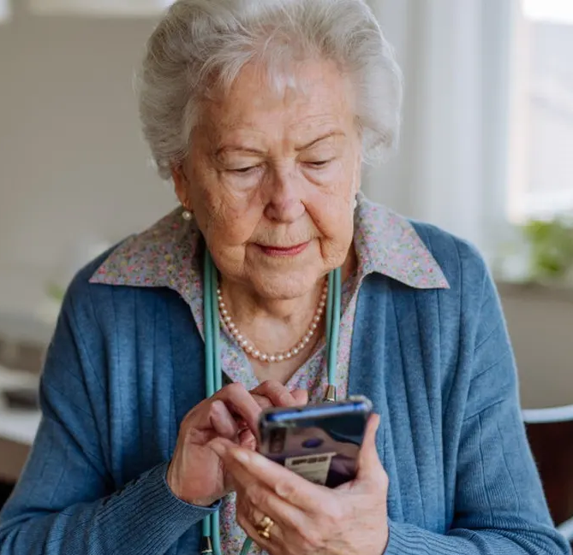
UI for requests
intuitive, simple design
readability
large font size
less elements
easy access
ANFRAGEN
NEUE ANFRAGE
Anfrage 1
Beschreiben Sie hier Ihr Problem...
Anfrage 2
Anfrage 3
NEUE ANFRAGE
ANFRAGE SENDEN

Slide 7
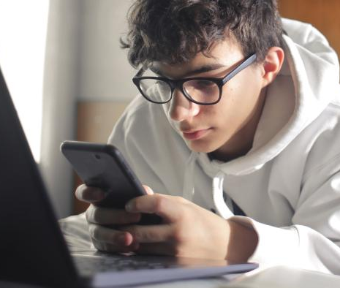






UI for helping
view of requests with search & filter options
feature richer
individual user profiles
incentive e. g. point system & scoreboard
Suche...
Filter...
Anfrage 1
Anfrage 2
Anfrage 3

Slide 8

Future ideas / extensions
more filters / categories
better matching
offering help with everyday tasks
include locations to make meeting in person easier
other incentives for volunteers to help
team events, …

Slide 9
Our Roadmap
brainstorming
meet with supervisor and volunteers
create frontend/ prototype
create backend/ features
project week
final presentation

Slide 10

Time for questions!

